Slide 1

Academic Session 2025-26
ODD Semester Jul-Dec 2025
UNIVERSITY INSTITUTE OF ENGINEERING
COMPUTER SCIENCE ENGINEERING
Bachelor of Engineering
BE-CSE/IT (5th Sem)
Design and Analysis of Algorithms
(23CSH-301/ITH-301)
Er. Richa Dhiman (E11307) richa.e11307@cumail.in
Master Subject Coordinator

Slide 2
Vision of University
“To be globally recognized as a Centre of Excellence for Research, Innovation, Entrepreneurship and disseminating knowledge by providing inspirational learning to produce professional leaders for serving the society.”

Slide 3
Mission of University
M1: Providing world class infrastructure, renowned academicians and ideal environment for Research, Innovation, Consultancy and Entrepreneurship relevant to the society.
M2: Offering programs & courses in consonance with National policies for nation building and meeting global challenges.
M3: Designing Curriculum to match International standards, needs of Industry, civil society and for inculcation of traits of Creative Thinking and Critical Analysis as well as Human and Ethical values.

Slide 4
Continued…
M4: Ensuring students delight by meeting their aspirations through blended learning, corporate mentoring, professional grooming, flexible curriculum and healthy atmosphere based on co-curricular and extra-curricular activities.
M5: Creating a scientific, transparent and objective examination/evaluation system to ensure an ideal certification.
M6: Establishing strategic relationships with leading National and International corporates and universities for academic as well as research collaborations.
M7: Contributing for creation of healthy, vibrant and sustainable society by involving in Institutional Social Responsibility (ISR) activities like rural development, welfare of senior citizens, women empowerment, community service, health and hygiene awareness and environmental protection.

Slide 5
Vision of Department
“To be recognized as a leading Computer Science and Engineering department through effective teaching practices and excellence in research and innovation for creating competent professionals with ethics, values and entrepreneurial attitude to deliver service to society and to meet the current industry standards at the global level.”

Slide 6
Mission of Department
M1: To provide practical knowledge using state-of-the-art technological support for the experiential learning of our students.
M2: To provide industry recommended curriculum and transparent assessment for quality learning experiences.
M3: To create global linkages for interdisciplinary collaborative learning and research.
M4: To nurture advanced learning platform for research and innovation for students’ profound future growth.
M5: To inculcate leadership qualities and strong ethical values through value based education.

Slide 7
Program Educational Objectives (PEOs)
PEO1: Engage in successful careers in industry, academia, and public service, by applying the acquired knowledge of Science, Mathematics and Engineering, providing technical leadership for their business, profession and community.
PEO2: Establish themselves as entrepreneur, work in research and development organization and pursue higher education.
PEO3: Exhibit commitment and engage in lifelong learning for enhancing their professional and personal capabilities.
.

Slide 8
Program Outcome (POs)
PO1: Engineering knowledge: Apply the knowledge of Mathematics, Science, Engineering fundamentals and computer science fundamental and strategies which have the solution of complex computer science engineering problems.
PO2: Problem analysis: Identify, formulate, research literature, and analyze complex computer science engineering problems reaching substantiated conclusions using first principles of mathematics, natural sciences, and engineering sciences.
PO3: Design/development of solutions: Design solutions for complex database and software engineering problems and design system components or processes that meet the specified needs with appropriate considerations for the public health and safety, and the cultural, societal, and environmental considerations.
PO4: Conduct investigations of complex problems: Use research-based knowledge and research methods including design of software engineering & networking based experiments, analysis and Interpretation of data, and synthesis of the information to provide valid conclusions.

Slide 9
Continued…
PO5: Modern tool usage: Create, select, and apply appropriate techniques, resources, and modern Computer science engineering and IT tools including prediction and modeling to complex database or software engineering activities with an understanding of the limitations.
PO6: The engineer and society: Apply reasoning informed by the contextual knowledge to assess
Social, health, safety, legal and cultural issues and the consequent responsibilities relevant to the Professional Computer Science & Engineering practice.
PO7: Environment and sustainability: Understand the impact of the professional computer science and engineering solutions in social and environmental contexts, and demonstrate the knowledge of, and need for sustainable development goals.
PO8: Ethics: Apply ethical principles and commit to professional ethics and responsibilities and norms of computer science engineering practice

Slide 10
Continued…
PO9: Individual and team work: Function effectively as an individual, and as a member or leader in diverse teams, and in multidisciplinary settings.
PO10: Communication: Communicate effectively on complex computer science engineering activities with the engineering community like CSI society at large, such as, being able to comprehend and write effective reports and design documentation, make effective presentations, and give and receive clear instructions.
PO11: Project management and finance: Demonstrate knowledge and understanding of the computer science engineering and management principles and apply these to one’s own work, as a member and leader in a team, to manage projects and in multidisciplinary environments.
PO12: Life-long learning: Recognize the need for, and have the preparation and ability to engage in independent and life- long learning in the broadest context of computer science engineering changes.

Slide 11
Continued…
PO 13: Value inculcation: Apply ethical principles and commit to professional ethics and responsibilities and norms of the engineering practice.
PO 14: Autonomy, responsibility and accountability: Demonstrate knowledge and understanding of the engineering and management principles and apply these to one’s work, as a member and leader in a team, to manage projects and in multidisciplinary environments.
PO 15: Environmental awareness and action: Understand the impact of the professional engineering solutions in societal and environmental contexts, and demonstrate the knowledge of, and the need for sustainable development.
PO 16: Community Engagement & Services.
PO 17: Empathy 17.1 Identify with or understand the perspective, experiences, or points of view of another individual or group, and to identify and understand other people’s emotions.

Slide 12
Program Specific Outcome (PSOs)
PSO1: Exhibit attitude for continuous learning and deliver efficient solutions for emerging challenges in the computation domain.
PSO2: Apply standard software engineering principles to develop viable solutions for Information Technology Enabled Services (ITES).

Slide 13
CHANDIGARH UNIVERSITY
The Academic Calendar for the Session 2025-26
ODD SEMESTER: JUL-DEC 2025
Date | Day | Activity | Category
01.07.2025 | Tue | Start of Registration 2nd Year onwards Students [All Programs] for ODD Semester [Session: 2025-26] [01.07.2025 to 14.07.2025] | University
15.07.2025 | Tue | Start of Odd Semester For 2nd Year and 4th Year [All Programs] Except MBA 2nd Year | Academics
16.07.2025 | Wed | Start of Odd Semester For 3rd Year and 5th Year [All Programs] | Academics
23.07.2025 | Wed | Orientation & Induction 1st Year [All Programs] Batch I [23.07.2025 to 29.07.2025] | Academics
24.07.2025 | Thu | Start of Odd Semester-1st Year [All Programs] Batch I | Academics
24.07.2025 | Thu | Start of Odd Semester MBA 2nd Year [USB & MBA APEX] | Academics
26.07.2025^{*1} | Sat | Academic Day - 1st Year [All Programs] Batch I & MBA 2nd Year [USB & MBA APEX] | Academics
11

Slide 14
CHANDIGARH UNIVERSITY
The Academic Calendar for the Session 2025-26
ODD SEMESTER: JUL-DEC 2025
Date | Day | Activity | Category
25.08.2025 | Mon | Orientation & Induction 1st Year [All Programs] Batch II [25.08.2025 to 27.08.2025] | Academics
26.08.2025 | Tue | Start of Odd Semester 1st Year [All Programs] Batch II | Academics
29.08.2025 | Fri | MST 01 [1st Hourly Test] 2nd Year Onwards [All Programs] [29.08.2025 to 02.09.2025] | Exams
29.08.2025 | Fri | MST 01 [1st Hourly Test] 1st Year [All Programs] Batch I [29.08.2025 to 02.09.2025] | Exams
20.09.2025 | Sat | Fresher’s Party-2025 Intake [All Programs] | Extra-Curr.
25.09.2025 | Thu | Orientation & Induction [International Students] 1st Year [All Programs] | Academics
26.09.2025 | Fri | Tech Fest [TechInvent] 2025 [26.09.2025 to 27.09.2025] | Co-Curr.
29.09.2025 | Mon | Practical MST All Years [All Programs] [29.09.2025 to 03.10.2025] | Academics
29.09.2025 | Mon | Global Education Submit 2025 [29.09.2025 to 01.10.2025] | OIA, Univ.
12

Slide 15
CHANDIGARH UNIVERSITY
The Academic Calendar for the Session 2025-26
ODD SEMESTER: JUL-DEC 2025
Date | Day | Activity | Category
06.10.2025 | Mon | MST 02 [2nd Hourly Test] All Years [All Programs] [06.10.2025 to 10.10.2025] | Exams
11.10.2025^{*2} | Sat | Academic Day - All Years [All Programs] | Academics
17.10.2025 | Fri | Diwali Extravaganza 2025 | Co-Curr.
20.10.2025 | Mon | Diwali Break for Students [20.10.2025 to 22.10.2025] | University
23.10.2025 | Thu | "Shabad Sangram National Literary Fest 2025 | Extra-Curr.
27.10.2025 | Mon | Law Conference/Conclave | UILS, Univ.
07.11.2025 | Fri | CU International Folklore Festival 2025 [07.11.2025 to 08.11.2025] | Extra-Curr.
12.11.2025 | Wed | Last Teaching Day - All Years [All Programs] | Academics
13

Slide 16
CHANDIGARH UNIVERSITY
The Academic Calendar for the Session 2025-26
ODD SEMESTER: JUL-DEC 2025
Date | Day | Activity | Category
13.11.2025 | Thu | End Sem. Practical Exam-Reg. & Reappear-All Years [All Programs] End-Term Evaluation for Projects [Evaluation Panel] [13.11.2025 to 18.11.2025] | Exams
19.11.2025 | Wed | End Sem. Theory Exams-Regular & Reappear-All Years [All Programs] [19.11.2025 to 11.12.2025] | Exams
11.12.2025 | Thu | End of Odd Semester - All Years [All Programs] | Academics
17.12.2025 | Wed | Convocation Week [17.12.2025 to 20.12.2025] | DSW, Univ.
24.12.2025 | Wed | Start of Registration for Even Semester-All Years [All Programs] [24.12.2025 to 03.01.2026] | University
02.01.2026 | Fri | Announcement of Results | Exams
Note: ^{*1} 26.07.2025 [Sat] will be an Academic Day for students of 1st Year [All Programs] Batch I & MBA 2nd Year [USB & MBA APEX] ^{*2} 11.10.2025 [Sat] will be an Academic Day for students of All Years [All Programs]
14

Slide 17
Course Information
Prerequisite: Basics of Computers and C/C++, Data Structures.
Objectives:
To understand the meaning and characteristics of algorithms.
To study different algorithm design techniques and data Structures.
To implement different algorithm design techniques for solving engineering and related problems.
To introduce P and NP classes.
L | T | P | C | CH
3 | 0 | 2 | 4 | 5

Slide 18
Course Outcomes
Outcomes:
CO1 | Understanding the key metrics that determine the algorithmic efficiency and identify various data structures applicable to a range of problems.
CO2 | Apply various data structures, sorting algorithms, String matching algorithms, graph algorithms and algorithmic techniques to solve computational problems effectively.
CO3 | Analyze the performance and efficiency of different algorithms in various scenarios, various classes for complex problems like P, NP and NP Complete, NP Hard.
CO4 | Evaluate and compare algorithmic strategies including dynamic programming, divide-and-conquer, greedy methods and Branch & Bound.
CO5 | Design and implement optimized solutions for complex problems using advanced algorithmic techniques.

Slide 19
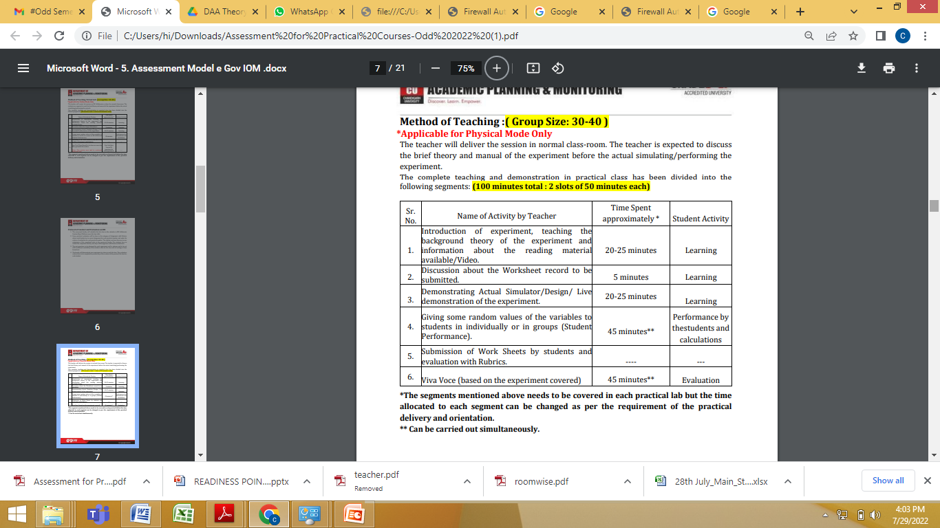
Method of Teaching

Slide 20
Evolution/History/Future Trends of Subject
Evolution/History:
Early Foundations (1950s-1970s)
1950s: The birth of computer science as a discipline. Early pioneers like Alan Turing and John von Neumann laid the groundwork for algorithmic thinking.
1960s: Development of fundamental algorithms and data structures. Key works include:
Donald Knuth's "The Art of Computer Programming," which provided a comprehensive treatment of algorithms and their analysis.
Introduction of sorting algorithms like QuickSort by Tony Hoare.
Development of the Fast Fourier Transform (FFT) by Cooley and Tukey.
1970s: Focus on algorithmic efficiency and complexity:
Introduction of the concept of NP-completeness by Stephen Cook and Richard Karp.
Development of dynamic programming and greedy algorithms.
Emergence of key graph algorithms (Dijkstra’s shortest path, Prim’s and Kruskal’s minimum spanning tree algorithms).

Slide 21
Evolution/History/Future Trends of Subject
Evolution/History:
Growth and Expansion (1980s-1990s)
1980s: Formalization and classification of algorithms:
Introduction of approximation algorithms for NP-hard problems.
Increased emphasis on parallel algorithms and distributed computing.
1990s: Advances in theoretical computer science and practical implementations:
Development of randomized algorithms.
Introduction of new data structures like Fibonacci heaps.
Growth of Internet and web algorithms (search algorithms, PageRank by Larry Page and Sergey Brin).

Slide 22
Evolution/History/Future Trends of Subject
Modern Developments (2000s-Present)
2000s: Focus on real-world applications and new paradigms:
Emergence of algorithms for big data and machine learning.
Development of bioinformatics algorithms.
Advances in cryptographic algorithms and security protocols.
2010s-Present: Emphasis on optimization and scalability:
Algorithms for deep learning and neural networks.
Distributed algorithms for cloud computing and blockchain technology.
Quantum algorithms and the potential of quantum computing.

Slide 23
Evolution/History/Future Trends of Subject
Future Trends:
Quantum Computing
Development of quantum algorithms that leverage quantum mechanics to solve problems more efficiently than classical algorithms (e.g., Shor's algorithm for factoring, Grover's search algorithm).
AI and Machine Learning
Integration of AI in algorithm design for adaptive and intelligent systems.
Development of algorithms that can learn and optimize themselves over time.
Big Data and Data Science
Creation of scalable algorithms for processing massive datasets.
Focus on real-time data processing and analysis.

Slide 24
Evolution/History/Future Trends of Subject
Future Trends:
Security and Cryptography
Evolution of cryptographic algorithms to counteract emerging threats.
Development of post-quantum cryptographic algorithms.
Interdisciplinary Applications
Algorithms tailored for specific fields like genomics, environmental modeling, and social network analysis.
Collaborative research across disciplines to develop more robust and versatile algorithms.

Slide 25
Importance of Subject (Placement Point of View)
Core Competency for Technical Roles
Problem-Solving Skills: Mastery of DAA demonstrates strong problem-solving abilities, which are essential for most technical roles in software development, data science, AI, and more.
Technical Interviews: Most technical interviews, especially for roles at top tech companies (e.g., Google, Amazon, Facebook), heavily focus on algorithmic problems and data structures. Proficiency in DAA is crucial to performing well in coding interviews.
Competitive Programming: Participation in competitive programming platforms (e.g., Codeforces, LeetCode, HackerRank) often requires a deep understanding of DAA. Success in these platforms can significantly boost a candidate’s profile.
Foundation for Advanced Topics
Understanding Complex Systems: A solid grasp of DAA is fundamental for understanding and designing complex systems, including distributed systems, databases, and real-time processing systems.
Efficient Coding Practices: Knowledge of efficient algorithms and data structures leads to writing optimized and high-performance code, which is valued in any software development role.

Slide 26
Importance of Subject (Placement Point of View)
Applicability Across Domains
Data Science and Machine Learning: DAA principles are essential in developing efficient machine learning models, processing large datasets, and optimizing performance.
Cybersecurity: Cryptographic algorithms and security protocols rely heavily on principles from DAA.
Web Development: Efficient algorithms are crucial for backend services, optimizing search engines, and ensuring scalable web applications.
Enhancing Problem-Solving Mindset
Analytical Thinking: Learning DAA fosters an analytical mindset, encouraging candidates to think critically about how to approach and solve complex problems.
Innovative Solutions: Exposure to various algorithmic techniques (e.g., dynamic programming, greedy algorithms) enables candidates to devise innovative solutions to new and existing problems.

Slide 27
Importance of Subject (Placement Point of View)
Career Growth and Opportunities
Higher Salaries: Roles that require strong algorithmic skills often come with higher salaries and better job security.
Versatile Career Path: Proficiency in DAA opens doors to various career paths, including software engineering, data analysis, AI research, and more.
Leadership and Mentorship: Experienced professionals with a strong foundation in DAA are well-positioned to take on leadership roles and mentor junior developers.
Preparation Strategies
Study Standard Texts: Books like "Introduction to Algorithms" by Cormen, Leiserson, Rivest, and Stein (CLRS) are highly recommended.
Practice Regularly: Regular practice on coding platforms and participating in algorithmic contests.
Understand Theoretical Foundations: Deepen your understanding of the theoretical underpinnings of algorithms to better apply them in practical scenarios.
Work on Projects: Apply algorithmic knowledge to real-world projects, showcasing your ability to implement efficient solutions.

Slide 28
Syllabus (Theory)
UNIT- 1
Chapter-1 (Algorithm and Program Performance) Designing and analyzing algorithms, Time and Space complexity, Average and worst-case Analysis, Asymptotic notations, recurrence equations and their solution: substitution method, recursion-tree method, master method. Chapter-2 (Review of Data Structures) Arrays, Stacks, Queues, Pointers, Linked Lists (One –way, Two-way and circular Two-way), Hashing, Trees (BST, B Tree, balanced trees (AVL, Red black trees)), Heaps, Graphs. Chapter-3 (Sorting Algorithm) Sorting in linear time: counting sort, radix sort, bucket sort.

Slide 29
Syllabus (Theory)
UNIT- 2
Chapter-4 (Divide and Conquer & Greedy Algorithms) Divide and conquer: The General method, Binary search, Finding maximum and minimum of a sequence of numbers, 2-way Merge sort, Quick sort, Selection sort, Strassen’s matrix multiplication. Greedy algorithms: The general method, Fractional Knapsack problem, Minimum cost spanning tree: Prim’s Algorithm, Kruskal Algorithm; Huffman coding, Optimal merge patterns Chapter-5 (Dynamic Programming) The general method, 0/1 knapsack, Subset Sum problem, Change making problem, optimal binary search tree, Matrix-chain Multiplication, longest common Subsequence Problem, Travelling salesman problem. Comparison of Divide & Conquer and Dynamic Programming techniques. Chapter-6 (Backtracking & Branch and Bound) Backtracking: The general method, N-queen’s problem, sum-of-subsets, Hamiltonian cycles. Branch and Bound: Branch and Bound method, 0/1 Knapsack problem, Travelling salesperson problem.

Slide 30
Syllabus (Theory)
UNIT- 3
Chapter-7 (Graph Algorithms) Representation of Graphs, Depth First Search, Breadth First search, Topological sort, Single source shortest path: Dijkstra Algorithm& Bellman Ford Algorithm. All-pair shortest paths: Floyd Warshall Algorithm, Minimum Spanning Tree: Sollin’s algorithm. Chapter-8 (Computational Complexity) Basic concepts, P and NP-classes, proof of NP-hard and NP-completeness. Chapter-9 (Miscellaneous Topics) Euclid Algorithm for GCD of 2 numbers, modulo arithmetic, Chinese remainder theorem, string manipulation/matching algorithms: Rabin Karp algorithm, KMP (Knuth-Morris-Pratt) algorithm, Boyer-Moore algorithm; Convex Hull.

Slide 31
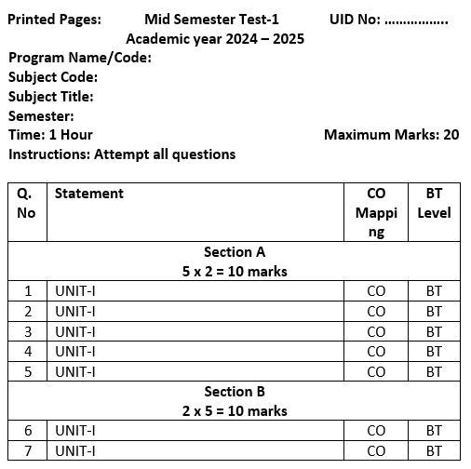
MST Model QP
20

Slide 32
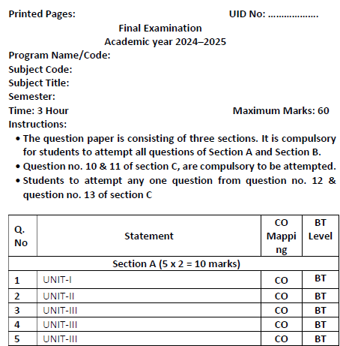
EST Model QP
21

Slide 33
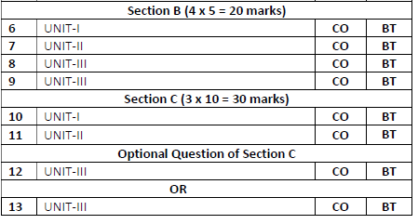
EST Model QP
22

Slide 34
References and Books
Text Books:
Cormen, T. H., Leiserson, C. E., Rivest, R. L., & Stein, C. (2022). Introduction to Algorithms (4th ed.). The MIT Press.
Horowitz, E., Sahni, S., & Rajasekaran, S. (2008). Fundamentals of Computer Algorithms (2nd ed.). Universities Press (India).
Sedgewick, R., & Wayne, K. (2011). Algorithms (4th ed.). Addison-Wesley.
Reference Books:
Tenenbaum, A. M., Augenstein, M. J., & Langsam, Y. (2009). Data Structures using C and C++ (2nd ed.). Prentice Hall of India.
Brassard, G., & Bratley, P. (1996). Fundamentals of Algorithmics. Prentice Hall of India.
Knuth, D. E. (2011). The Art of Computer Programming, Volume 1: Fundamental Algorithms (3rd ed.). Addison-Wesley.
Lipschutz, S. (2014). Data Structures, Schaum's Outline Series (2nd ed.). Tata McGraw-Hill.
Kruse, R. L., Tondo, C. L., & Leung, B. (1997). Data Structures and Program Design in C (2nd ed.). Prentice Hall.
Aho, A. V., Hopcroft, J. E., & Ullman, J. D. (1974). The Design and Analysis of Computer Algorithms. Pearson.

Slide 35
E- Learnings links
Topic Name | Video link
Asymptotic Notations | https://www.youtube.com/watch?v=7dz8Iaf_weM&t=360s
Solve recurrence relation using Substitution method | https://www.youtube.com/watch?v=VHGisohk3Ck
Solve recurrence relation using Master Theorem | https://www.youtube.com/watch?v=OynWkEj0S-s&t=885s
Solve recurrence relation using Recursive tree | https://www.youtube.com/watch?v=bJg_sv7PV-g&t=15s
Creation, Insertion in BST tree | https://www.youtube.com/watch?v=cySVml6e_Fc
Creation, Insertion in AVL tree | https://www.youtube.com/watch?v=YWqla0UX-38
Counting Sort algorithm | https://www.youtube.com/watch?v=pEJiGC-ObQE
Bubble Sort algorithm | https://www.youtube.com/watch?v=7aVvaUK3-2s
Radix Sort algorithm | https://www.youtube.com/watch?v=6du1LrLbDpA
Stack | https://www.youtube.com/watch?v=7m1DMYAbdiY&t=16s
Linked Lists | https://www.youtube.com/watch?v=q8gdBn9RPeI&list=PLDzeHZWIZsTr54_TH_NK4ibFojS4mmQA6
2 way Merge sort | https://www.youtube.com/watch?v=6pV2IF0fgKY

Slide 36
E- Learnings links
Topic Name | Video link
Binary Search | https://www.youtube.com/watch?v=V_T5NuccwRA
Finding maximum and minimum of a sequence of numbers | https://www.youtube.com/watch?v=GVFXYrMRqFw
Strassen’s matrix multiplication | https://www.youtube.com/results?search_query=Strassen%E2%80%99s+matrix+multiplication
Fractional Knapsack problem | https://www.youtube.com/watch?v=xZfmHVi7FMg&t=2s
Huffman coding | https://www.youtube.com/watch?v=saofdNsZiYY&t=103s
0/1 knapsack problem | https://www.youtube.com/watch?v=PfkBS9qIMRE
Subset Sum problem | https://www.youtube.com/watch?v=dJmyfFC3-3A
Matrix-chain Multiplication | https://www.youtube.com/watch?v=prx1psByp7U
Longest common Subsequence Problem | https://www.youtube.com/watch?v=jHGgXV27qtk

Slide 37
E- Learnings links
Travelling salesman problem | https://www.youtube.com/watch?v=hh-uFQ-MGfw
N-queen’s problem | https://www.youtube.com/watch?v=xFv_Hl4B83A
Hamiltonian cycles | https://www.youtube.com/watch?v=dQr4wZCiJJ4
0/1 Knapsack problem | https://www.youtube.com/watch?v=yV1d-b_NeK8
Travelling salesperson problem | https://www.youtube.com/watch?v=1FEP_sNb62k
P,NP classes | https://www.youtube.com/watch?v=e2cF8a5aAhE&t=333s
Rabin Karp Algo | https://www.youtube.com/watch?v=qQ8vS2btsxI
Dijkstra’s algo | https://www.youtube.com/watch?v=smHnz2RHJBY
Floyd Warshall | https://www.youtube.com/watch?v=Gc4mWrmJBsw&t=555s
Knuth Morris Pratt (KMP) also | https://www.youtube.com/watch?v=V5-7GzOfADQ

Slide 38
Syllabus (LAB)
UNIT- 1
Experiment 1.1 | Analyze if the stack is empty or full, and if elements are present, return the top element in the stack using templates. Also, perform push and pop operations on the stack.
Experiment 1.2 | Develop a program for implementation of power function and determine that complexity should be O(log n) .
Experiment 1.3 | Evaluate the complexity of the developed program to find frequency of elements in a given array.
Experiment 1.4 | Apply the concept of Linked list and write code to Insert and Delete an element at the beginning and end of Singly Linked List. Apply the concept of Linked list and write code to Insert and Delete an element at the beginning and at end in Doubly and Circular Linked List.

Slide 39
Syllabus (LAB)
UNIT- 2
Experiment 2.1 | Sort a given set of elements using the Quick sort method and determine the time required to sort the elements. Repeat the experiment for different values of n, the number of elements in the list to be sorted. The elements can be read from a file or can be generated using the random number generator.
Experiment 2.2 | Develop a program and analyze complexity to implement subset-sum problem using Dynamic Programming.
Experiment 2.3 | Develop a program and analyze complexity to implement 0-1 Knapsack using Dynamic Programming.

Slide 40
Syllabus (LAB)
UNIT- 3
Experiment 3.1 | Develop a program and analyze complexity to find shortest paths in a graph with positive edge weights using Dijkstra’s algorithm.
Experiment 3.2 | Develop a program and analyze complexity to find all occurrences of a pattern P in a given string S.
Experiment 3.3 | Lab Based Mini Project

Slide 41
Content Beyond Syllabus (Theory)
Advanced Data Structures:
Suffix Trees and Suffix Arrays: Useful for string processing and pattern matching.
Fibonacci Heaps: Used in improved implementations of Dijkstra's and Prim's algorithms.
Specialized Algorithms:
String Matching and Processing: Advanced algorithms like Aho-Corasick, Ukkonen's algorithm, and suffix automata.
Computational Geometry: Algorithms for geometric problems like Voronoi diagrams, Delaunay triangulation, and line segment intersection.
Quantum Algorithms:
Shor’s Algorithm: For integer factorization.
Grover’s Algorithm: For database search.
Quantum Walks: Quantum analog of classical random walks, used in various algorithmic contexts.

Slide 42
Content Beyond Syllabus (Theory)
Machine Learning Algorithms:
Boosting and Bagging: Techniques to improve the performance of machine learning models.
Support Vector Machines (SVM): For classification problems.
Deep Learning Architectures: Algorithms for training deep neural networks.
Cryptographic Algorithms:
Public Key Cryptography: RSA, ECC (Elliptic Curve Cryptography).
Symmetric Key Algorithms: AES, DES.
Hash Functions: SHA-256, MD

Slide 43
Content Beyond Syllabus (Lab)
Code for enqueue, dequeue, Isfull and Isempty operation in queues using templates.
Code and analyze to sort an array of integers using Merge sort
Code to find the height of a Binary tree with Analysis
Code to find the ignored successor in an Binary Search Trees with complexity Analysis.
To implement maximum and minimum problem using divide and conquer strategy.
To implement binary search using divide and conquer strategy.
To implement LCS Problem using Dynamic Programming.
Code and analyze to find an optimal solution to matrix chain multiplication using dynamic programming.
Code and analyze to find shortest paths in a graph with arbitrary edge weights using Bellman-Ford algorithm.
To implement KMP (Knuth-Morris-Pratt) algorithm.
To implement Prim’s algorithm for minimum spanning tree.
To implement Kruskal’s algorithm for minimum spanning tree.

Slide 44
Complex Problems (LAB) (MIN- 10)

Slide 45
Complex Problems (LAB) (MIN- 10)

Slide 46
Complex Problems (LAB) (MIN- 10)

Slide 47
Complex Problems (LAB) (MIN- 10)

Slide 48
Complex Problems (LAB) (MIN- 10)

Slide 49
Complex Problems (LAB) (MIN- 10)

Slide 50
Complex Problems (LAB) (MIN- 10)

Slide 51
Complex Problems (LAB) (MIN- 10)

Slide 52
Complex Problems (LAB) (MIN- 10)

Slide 53
Complex Problems (LAB) (MIN- 10)

Slide 54
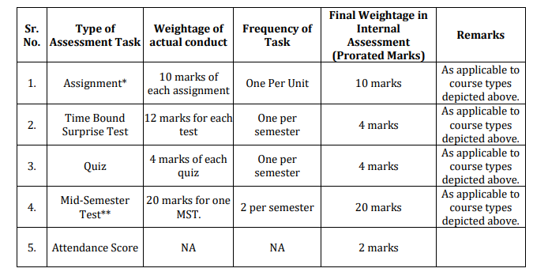
Assessment Model (Theory)

Slide 55
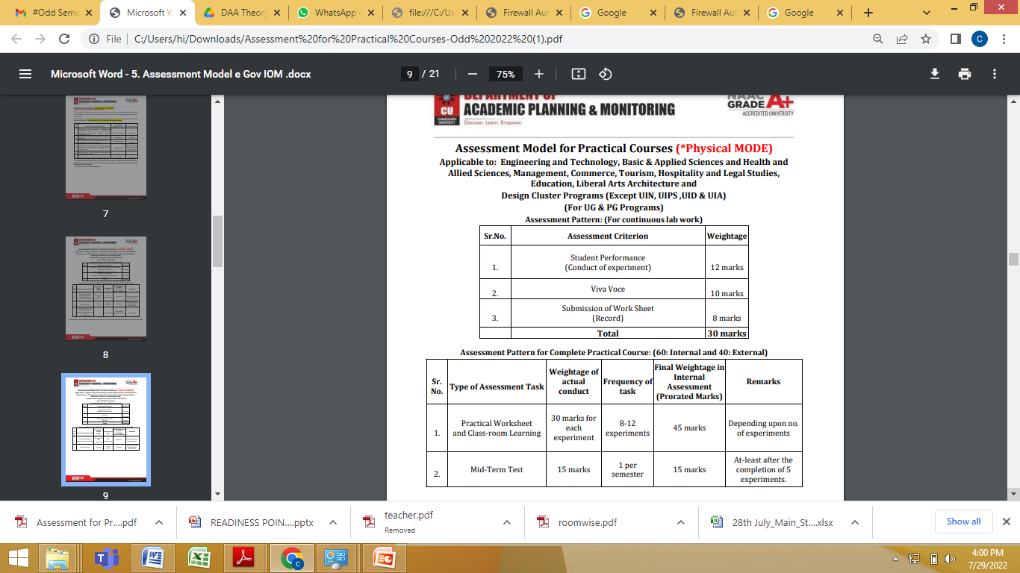
Assessment Model (Practical)

Slide 56
For 9th Experiment
15 marks for experiment + 15 marks for Complex/Average/Slow Learner’s Problem

Slide 57
Continuous Assessment Sheet Format
S.no | UID | StudentName | Section | Course Code | Experiment No 1 to 10
 |  |  |  |  | Conduct 12 | Viva 10 | Worksheet 8 | Total
Bifurcation of the 30 marks is as follows:
Conduct: 12 Marks
Viva Voce: 10 Marks
Worksheet: 8 Marks
Bifurcation for Practical’s July-Dec,2024.
Conduct: 12 Marks Rubrics | Viva Voce: 10 Marks Rubrics | Worksheet: 8 Marks Rubrics
8 marks for logic followed according to the problem statement. 4 marks for code writing skills. | 5 viva Question 2 marks each | Aim- 1 Mark Objective- 1 Mark Input/Apparatus Used- 1 Mark Procedure- 1 Mark Code- 2 Mark Output- 2 Mark

Slide 58
External Practical Evaluation Rubrics Assessment Criteria
Performance/Conduct : 10 Marks | Viva Voce: 15 Marks | Written Worksheet : 15 Marks
6 marks for logic followed according to the problem statement. | Minimum 5 viva Question 3 marks each. | 8 marks for proper all parameters included (Aim, Objective, Input/Apparatus Used, Procedure, Code).
4 marks for code writing skills. |  | 5 marks for Logic
 |  | 2 marks for Output
Bifurcation of the 40 marks for External Practical is as follows:

Slide 59
CO-PO MAPPING
Course Outcome | PO1 | PO2 | PO3 | PO4 | PO5 | PO6 | PO7 | PO8 | PO9 | PO1 0 | PO1 1 | PO12 | PO13 | PO14 | PO15 | PO16 | PO17 | PSO1 | PSO2
CO1 | 3 | 3 | 2 | 1 | 1 | 3 | 2 | 1 | - | 2 | 2 | - | 1 | 1 | - | - | - | 2
CO2 | 3 | 3 | 3 | 2 | 2 | 3 | 2 | 1 | 1 | 2 | 3 | 1 | 1 | 1 | 1 | - | - | 3 | 2
CO3 | 3 | 3 | 3 | 2 | - | 3 | 2 | - | - | 2 | 2 | - | 1 | - | 1 | - | -
CO4 | 2 | 3 | 3 | 2 | 1 | 3 | 3 | 1 | - | 2 | 3 | - | 1 | 1 | - | - | - | 2
CO5 | 3 | 3 | 3 | 3 | 2 | 3 | 3 | 2 | 2 | 3 | 3 | 1 | 2 | 2 | 1 | 1 | 1 | 3 | 2
AVG | 2.8 | 3 | 2.8 | 2 | 1.5 | 3 | 2.4 | 1.25 | 1.5 | 2.2 | 2.6 | 1 | 1.2 | 1.25 | 1 | 1 | 1 | 2.5 | 2

Slide 60
Mini Projects (MIN 36)
Sr. No | Title of Project | DOMAIN | Description | Hardware/Soft Requirement | Technology | Objective | Targeted Outcome
21. | Strategic Game Mastery: Algorithmic Approaches to Play Classic Games with Minimax, Alpha-Beta Pruning, and Beyond | Game Development, AI | Create algorithms to play classic games like Tic-Tac-Toe, Connect Four, or Chess. You can implement minimax, alpha-beta pruning, and other game-playing techniques | Programming environment (e.g., Python, Java) | AI techniques (e.g., Minimax, Alpha-Beta Pruning), game dev frameworks | Create intelligent agents capable of making strategic decisions in games | AI opponents with varying levels of difficulty in games
22. | Graph Harmony Assessment: Algorithmic Isomorphism Analysis for Structural Equivalence | Graph Theory, Network Analysis | Develop an algorithm that determines whether two given graphs are isomorphic by analyzing their structures | Programming environment (e.g., Python, C++) | Graph isomorphism algorithms, graph analysis libraries | Provide a solution for graph comparison and similarity analysis | Determining whether two graphs have the same underlying structure
23. | Bin Packing Brilliance: Online Algorithms for Efficiently Packing Items into Fixed Capacity Bins | Algorithms, Resource Allocation | Implement online algorithms for the bin packing problem, where items need to be packed into bins of fixed capacity | Programming environment (e.g., Python, Java) | Bin packing algorithms, resource allocation libraries | Optimize the allocation of items into containers while handling new arrivals | Efficient packing of items in real-time scenarios
24. | Data Elegance in Bits: Exploring and Implementing Huffman Coding and Lempel-Ziv-Welch (LZW) Compression Algorithms | Data Compression, Information Theory | Explore and implement data compression algorithms like Huffman coding or Lempel-Ziv-Welch (LZW) compression | Programming environment (e.g., Python, C++) | Data compression algorithms, compression libraries | Develop methods to save storage space and transmit data more efficiently | Smaller file sizes for storage and faster data transmission

Slide 61
Mini Projects (MIN 36)
Sr. No | Title of Project | DOMAIN | Description | Hardware/Soft Requirement | Technology | Objective | Targeted Outcome
25. | Unpredictable Efficiency: Exploring and Implementing Randomized Algorithms for Computational Problem Solving | Algorithms, Probabilistic Methods | Study and implement randomized algorithms like random selection, random quicksort, or the Monte Carlo method for solving computational problems | Programming environment (e.g., Python, Java) | Randomized algorithms | Provide solutions that are fast on average and probabilistic in nature | Efficient solutions for certain problems where randomness can help
26. | Optimal Time Management: Algorithmic Solutions for Interval Scheduling to Maximize Task Efficiency | Algorithms, Scheduling | Design an algorithm that solves interval scheduling problems to maximize the number of tasks scheduled without overlapping | Programming environment (e.g., Python, Java) | Interval scheduling algorithms | Optimize the allocation of resources subject to interval constraints | Effective scheduling of time-bound tasks
27. | Hashing Horizons: Exploring Open Addressing and Chaining Techniques with Performance Analysis for Collision Handling | Data Storage, Data Retrieval | Create a program that demonstrates various hashing techniques like open addressing and chaining, and compare their performance in terms of collisions and load factor. | Programming environment (e.g., Python, Java) | Hashing algorithms, data retrieval methods | Efficiently map data to fixed-size hash values for quick access | Fast data retrieval and storage using hash functions
28. | Graph Partition Prowess: Algorithmic Design for Optimized Disjoint Subgraph Division with Cut Size Minimization and Balance Maximization | Algorithms, Graph Theory | Design an algorithm that partitions a graph into two or more disjoint subgraphs while optimizing certain criteria, such as minimizing the cut size or maximizing the balance. | Programming environment (e.g., Python, Java) | Graph partitioning algorithms | Create a solution to efficiently partition graphs into subsets that adhere to specific criteria, such as minimizing edge cuts or balancing node weights | Improved organization and analysis of graph data, enhanced network performance, and more efficient data distribution

Slide 62
Mini Projects (MIN 36)
Sr. No | Title of Project | DOMAIN | Description | Hardware/Soft Requirement | Technology | Objective | Targeted Outcome
29. | Subarray Summit: Algorithmic Solutions for Maximum Subarray Problem to Find the Optimal Contiguous Sum | Algorithms, Optimization | Create algorithms to solve the maximum subarray problem, finding the contiguous subarray with the largest sum within a given array. | Programming environment (e.g., Python, Java) | Subarray problem-solving algorithms | Develop efficient algorithms to identify the subarray that provides the largest sum of its elements. | Effective solutions for identifying the most profitable or significant contiguous segments within datasets, leading to better decision-making in various domains
30. | Vertex Vistas: Exploring Algorithms for Maximal Independent Sets in Graphs through Brute Force and Approximation | Graph Theory, Optimization | Implement algorithms to find the maximal independent set of vertices in a graph, exploring both brute force and approximation methods. | Computer, programming environment | Maximal independent set algorithms | Design solutions to identify subsets of nodes that are mutually disconnected, forming a larger independent set. | Discovery of groups of nodes that can be treated as separate entities, aiding in tasks like social community detection or optimizing resource allocation in networks
31. | Network Resilience Enhancer | Network Management, Optimization | Develop algorithms to enhance network resilience by strategically placing nodes and allocating redundancy, ensuring minimal disruption in case of failures. | Programming environment (e.g., Python, Java), network simulation libraries, optimization frameworks | Network simulation tools, optimization algorithms | Improve network reliability and robustness, reduce downtime during failures. | Enhanced network resilience, minimized disruptions during failures.
32. | Dynamic Pricing Dynamo | E-commerce, Pricing Strategies | Design algorithms for dynamic pricing, considering factors like demand, competition, and inventory levels, to optimize revenue and profit in online retail environments. | Programming environment (e.g., Python, Java), pricing optimization libraries, data analysis tools | Dynamic pricing algorithms, data analytics platforms | Increase revenue, improve competitiveness in online markets. | Improved revenue generation, enhanced market competitiveness.

Slide 63
Mini Projects (MIN 36)
Sr. No | Title of Project | DOMAIN | Description | Hardware/Soft Requirement | Technology | Objective | Targeted Outcome
33. | Circuit Optimization Maestro | Electronics, Power Management | Develop algorithms to optimize electronic circuit design for minimal power consumption, considering factors like component selection, layout, and signal routing. | Circuit simulation software, programming environment (e.g., Python, C++), optimization libraries | Circuit design tools, optimization algorithms | Reduce energy consumption, extend battery life in electronic devices. | Reduced power consumption, prolonged battery life in electronic devices.
34. | Anomaly Detection Ace | Data Analytics, Anomaly Detection | Implement algorithms for detecting anomalies in time-series data, enabling early identification of unusual patterns or events in various domains like finance, IoT, or cybersecurity. | Programming environment (e.g., Python, R), machine learning libraries, time-series analysis tools | Machine learning algorithms, time-series analysis techniques | Improve security, minimize risks and losses through early anomaly detection. | Enhanced security posture, reduced impact of anomalous events.
35. | Smart Inventory Manager | Supply Chain Management, Inventory Control | Design algorithms for inventory management, incorporating demand forecasting, lead time optimization, and inventory replenishment strategies to minimize costs and stockouts. | Programming environment (e.g., Python, Java), supply chain management software, optimization frameworks | Inventory management systems, optimization algorithms | Reduce holding costs, improve customer satisfaction, and optimize inventory levels. | Reduced inventory costs, enhanced customer service levels.
36. | Sentiment Analysis Sentinel | Natural Language Processing, Sentiment Analysis | Develop algorithms for sentiment analysis to automatically classify the sentiment expressed in textual data, enabling insights into public opinion, customer feedback, and social media trends. | Programming environment (e.g., Python, Java), natural language processing libraries, sentiment analysis frameworks | Text processing tools, sentiment analysis techniques | Enhance decision-making based on customer sentiment, improve brand reputation management. | Informed decision-making, improved brand perception.

Slide 64
Future Scope
1. Quantum Computing
Quantum Algorithms: Development of new quantum algorithms that can solve problems more efficiently than classical algorithms. For example, Shor's algorithm for factoring and Grover's search algorithm.
Optimization: Quantum algorithms for optimization problems could revolutionize fields like cryptography, logistics, and machine learning.
2. Artificial Intelligence and Machine Learning
Algorithm Efficiency: Improving the efficiency of algorithms used in training and deploying AI models.
Automated Algorithm Design: AI systems that can automatically design and optimize algorithms for specific tasks.
3. Big Data and Data Science
Scalability: Algorithms that can handle and process massive datasets efficiently.
Real-Time Processing: Development of algorithms for real-time data analytics and decision-making.

Slide 65
Future Scope
4. Cybersecurity
Post-Quantum Cryptography: Designing cryptographic algorithms that are secure against quantum attacks.
Intrusion Detection: Algorithms for detecting and responding to security threats in real-time.
5. Internet of Things (IoT)
Resource Optimization: Algorithms for optimizing the use of limited resources (e.g., power, bandwidth) in IoT networks.
Data Aggregation: Efficient algorithms for collecting and processing data from numerous IoT devices.
6. Bioinformatics and Computational Biology
Genomic Analysis: Algorithms for analyzing and interpreting genomic data.
Protein Folding: Efficient algorithms for predicting the 3D structure of proteins from their amino acid sequences.

Slide 66
Future Scope
7. Blockchain and Cryptocurrencies
Consensus Algorithms: Development of more efficient and secure consensus algorithms for blockchain networks.
Cryptographic Primitives: Advanced cryptographic algorithms for secure and private transactions.
8. Autonomous Systems
Path Planning: Algorithms for efficient path planning and navigation in autonomous vehicles and robots.
Decision Making: Real-time decision-making algorithms for autonomous systems.
9. Human-Computer Interaction
Adaptive Algorithms: Algorithms that adapt to user behavior and preferences to provide a more personalized experience.
Natural Language Processing: Continued improvement of algorithms for understanding and generating human language.

Slide 67
Future Scope
10. Environmental and Social Impact
Sustainable Computing: Algorithms that minimize energy consumption and maximize the use of renewable resources.
Social Good: Algorithms designed to address social issues such as healthcare, education, and disaster response.
11. Advanced Theoretical Research
Complexity Theory: Further exploration of the boundaries of computational complexity.
New Paradigms: Development of new algorithmic paradigms and frameworks for emerging types of computation.

Slide 68
Target Placement Companies
Industry | Company | Focus Areas
Technology Giants | Google | Search algorithms, machine learning, data mining
 | Facebook (Meta) | Social network algorithms, AI, data analytics
 | Microsoft | Software development, AI, cloud computing
 | Amazon | Cloud computing, logistics, AI, e-commerce
 | Apple | Hardware-software integration, machine learning
Financial Services and FinTech | Goldman Sachs | Financial modeling, algorithmic trading, risk management
 | Morgan Stanley | Quantitative analysis, financial engineering
 | JPMorgan Chase | Data science, financial algorithms
 | Bloomberg | Financial data analytics, trading systems

Slide 69
Target Placement Companies
Industry | Company | Focus Areas
Consulting Firms | McKinsey & Company | Data analysis, problem-solving for consulting
 | Boston Consulting Group (BCG) | Data-driven decision-making, strategic planning
 | Bain & Company | Data science, analytics in consulting
Research and Development | IBM Research | AI, quantum computing, data science
 | Bell Labs (Nokia) | Telecommunications, networks, advanced algorithms
Internet and E-Commerce | Netflix | Recommendation systems, content delivery
 | Airbnb | Search algorithms, matching, data-driven decisions
 | Uber | Dynamic pricing, routing, logistics

Slide 70
Placement Related Questions
Industry | Company | Focus Areas
Artificial Intelligence and Machine Learning | OpenAI | Advanced AI, machine learning algorithms
 | DeepMind (Google) | AI research, machine learning, neural networks
 | NVIDIA | AI algorithms, machine learning, graphics processing
Startups and Innovative Companies | Palantir | Data integration, analytics
 | Stripe | Financial transactions, fraud detection
 | Snowflake | Data warehousing, cloud computing
Telecommunications | Qualcomm | Communication systems, signal processing
 | Ericsson | Network optimization, 5G technology, IoT

Slide 71
Placement Related Questions
Industry | Company | Focus Areas
Government and Defense | DARPA (Defense Advanced Research Projects Agency) | Advanced algorithms for defense and technology
 | NASA | Space exploration algorithms, data analysis
Academia and Research Institutions | MIT (Massachusetts Institute of Technology) | Research in computer science and algorithms
 | Stanford University | Advanced algorithms, theoretical computer science
 | Carnegie Mellon University | Algorithms research, AI development

Slide 72
Placement Related Questions
Algorithm Design and Problem Solving
Design an algorithm to find the longest palindromic substring in a given string.
How would you implement a function to merge two sorted linked lists?
Describe an algorithm to solve the "Traveling Salesman Problem" using dynamic programming.
Design an algorithm to find the kth largest element in an unsorted array.
How would you detect a cycle in a directed graph?
Data Structures
Explain how a hash table works and how you would handle collisions.
Implement a binary search tree and write a function to find its height.
Describe the differences between a stack and a queue. Provide examples of when to use each.
Implement a priority queue using a heap.
What is a trie and how would you use it to implement an autocomplete feature?

Slide 73
Placement Related Questions
Complexity Analysis
Explain the time complexity of binary search.
Compare and contrast the time complexities of QuickSort and MergeSort.
What is the space complexity of an in-place sorting algorithm?
How would you optimize an algorithm with exponential time complexity?
Analyze the time complexity of Dijkstra’s algorithm.

Slide 74
Placement Related Questions
Conceptual Questions
Algorithm Paradigms
Describe the difference between dynamic programming and greedy algorithms. Provide an example where each is appropriate.
Explain the concept of divide and conquer. How is it used in the MergeSort algorithm?
What is backtracking and in which scenarios is it useful?
Discuss the use of memoization in dynamic programming.
What are NP-complete problems and why are they important?

Slide 75
Placement Related Questions
Graph Algorithms
How does Breadth-First Search (BFS) differ from Depth-First Search (DFS)?
Describe how to find the shortest path in a weighted graph.
Explain the concept of a minimum spanning tree and how you would find it.
What is topological sorting and in what kind of problems is it useful?
How would you detect and handle negative cycles in a graph?
Sorting and Searching
What are the advantages and disadvantages of QuickSort?
How does binary search work and what are its limitations?
Explain how you would implement a search algorithm for a rotated sorted array.
Describe how radix sort works and in which scenarios it is useful.
How do you find the median of two sorted arrays?

Slide 76
Placement Related Questions
Practical Coding Questions
Implementation and Optimization
Write a function to reverse a linked list.
Implement the Fibonacci sequence using dynamic programming.
Write a program to find the longest common subsequence of two strings.
Implement an algorithm to check if a string contains all unique characters.
Write a function to perform matrix multiplication.
Real-World Scenarios
Design a recommendation system algorithm.
Implement a cache system using LRU (Least Recently Used) policy.
Write an algorithm to balance a binary search tree.
Design an algorithm to solve the knapsack problem.
How would you design a URL shortening service like bit.ly?

Slide 77
Placement Related Questions
Behavioral Questions
Teamwork and Collaboration
Describe a time when you worked on a team project. How did you ensure that the algorithmic solutions were effective?
How do you handle disagreements when collaborating on algorithm design?
Explain a situation where you had to optimize an existing algorithm. What approach did you take?
Problem-Solving Approach
Describe your approach to solving a complex algorithmic problem.
How do you stay current with the latest developments in algorithms and data structures?
Can you give an example of a particularly challenging algorithmic problem you’ve solved? How did you approach it?

Slide 78
Placement Related Questions
Project Experience
Discuss a project where you applied your knowledge of algorithms and data structures.
What is the most complex algorithm you’ve implemented in a project, and what was its purpose?
Describe a scenario where you had to choose between multiple algorithmic solutions. How did you make your decision?

Slide 79
Thank You

